Slide 1

Accounting for Legacies

Slide 2
The legacy market and roll of the ILM
Charities are expected to receive £3.4bn of legacies in 2021. By 2030 that is forecast to be £5bn a year.
Legacies are an increasingly crucial source of income for UK charities accounting for 27% of voluntary charitable income although for most member charities it is well above this amount. However, with legacy income growing faster than other income sources the reliance on legacies is increasing significantly.
ILM has 600 members at just less than 400 charities and our members administer £2.7bn of income.
Our members are often from a professional background such as law or accountancy and they then do a wide range in training with us including our Certificate in Charity Legacy Administration.
Members sit in various teams within their charities but mainly finance, legal or fundraising.

Slide 3
What we have done to inform our submissions to the committee?
We have surveyed our members getting responses from around 44 UK charities representing around 11% of the charities we represent. This data is provided separately with key data included within this slide deck.
We have canvassed the views of members individually as well as key stakeholders including Legacy Foresight who are the leading economists and analysts for the sector, along with Clear who produce the leading software used by the sector to account for and administer legacies and Legacy Link who provide locum support to charities. We provide quotes from these organisations at the end of this slide deck.
We have also been part of the SORP PAT Strand A engagement group over the past year and discussed the views with the engagement group including the submission made by the engagement strand. It is however important to note that we are not using this submission to present on behalf of the engagement strand.

Slide 4
Key Submissions
In the interest of readers of charity accounts, it would be helpful if all charities in receipt of an identical gift include the same value for that legacy in their accounts.
It is preferable for executors to have one method of accounting so that they can start to understand charities needs and work to provide all beneficiaries with the necessary information at the relevant time.
It is preferable for charities to have one method of accounting for legacies as this allows for:
  Software to be improved which leads to significant efficiencies resulting from better processes and potentially greater automation. This would probably result in fewer errors and therefore even more efficient use of charity resources.
  Better forecasting techniques. With legacy income increasingly being the key source of income trustees benefit from accurate forecasting. Forecasting is currently inhibited by the variation of accounting methods and Legacy Foresight continue to
  Improved training to be provided by ILM with corresponding efficiency benefits especially when legacy officers move from one charity to another. Charities should be including as much information as possible about the legacies they are aware of within their annual report.
The identity and nature of a charity do not have any impact on the value they will eventually receive from a legacy suggesting they should probably account for identical legacies in the same way.

Slide 5
What is wrong with SORP 2015?
sections 5.29 to 5.37 of SORP 2015 lack clarity, particularly as to what constitutes entitlement, probability of receipt and measurement but also in respect of adjusting events.
It is not clear whether charities should be recognising income early on the basis of estimated estate expenses or whether they should wait until they have proper information in relation to those expenses.
A significant issue is that the guidelines makes reference to the executors being satisfied that there are funds available in the estate. This is too subjective and driven allows the risk perception of individual executor to be a driving force in what legacies are accounted for by charities.
Subsequently there is considerable variance in the accounting polices charities adopt, and which auditors approve, in respect of legacies.
Many charities spend considerable resources monitoring legacy income after the end of their usual cut off period for an accounting period. This means that charities must live with considerable uncertainty about the amount of income from legacies until the accounts are signed. Charities and their auditors lack confidence that only clearly material individual legacies require inclusion as adjusting events.

Slide 6
What is wrong with SORP 2015
The lack of consistency in legacy accounting appears to conflict with most of the relevant accounting standards seek to deliver a consistent approach. Selective quote from these standards highlight this below.
SORP FRS 102
to enhance relevance and comparability
to assist those responsible for preparation
FRS 102
cost effectiveness
consistent principles
IASB
clearly articulated principles
IPSASB
Supports convergence of standards

Slide 7
Survey of ILM member attitudes to SORP
Every single respondent unsurprisingly confirmed that they thought that a charity’s annual report should provide the true indication of the charity's finances at year end?
84% of respondents agreed that it was preferable that charities report in the same way. However, the written responses to this question revealed concerns about the practicality of this and the commission is urged to look at the survey data provided.

Slide 8
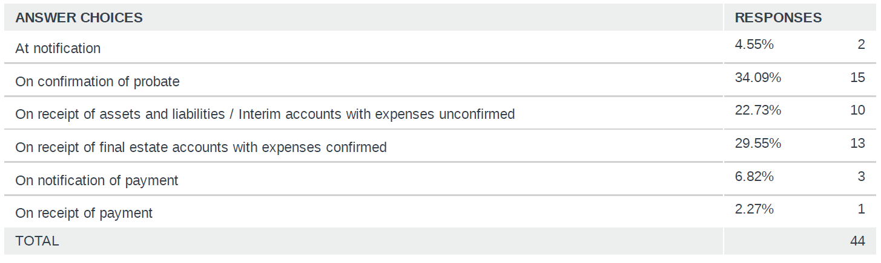
Which of the following best describes when your charity recognises legacy income?
It is not unreasonable to group the responses of those who recognise income at probate with those who do so on interim accounts before expenses are confirmed.
The sector and their auditors are slow to recognise that the net estate for probate is in fact the first interim account and effectively is little different.
It appears the SORP may be at fault due to its reference to executors confirmation that they are happy there are sufficient assets in the estate.

Slide 9
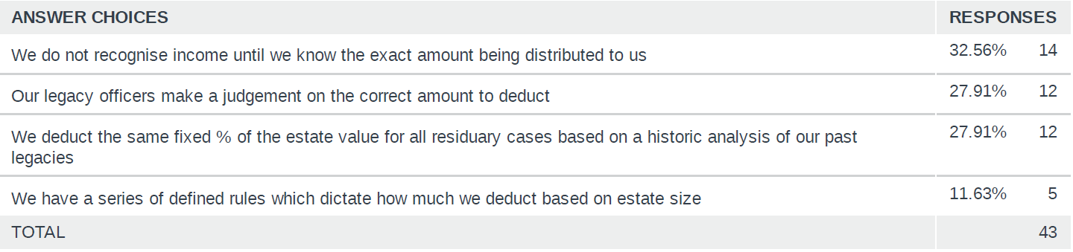
If your charity recognises income before the exact amount receivable is defined, how do you account for the costs of administering the estate?
It appears there is scope for the ILM or some other body to provide better guidance on the best way to estimate the proper deduction for expenses.
The committee needs to decide if it is acceptable for a third of charities to not account for income from legacies on the basis that they feel unable to measure the value of the gift until they are clear about the value of the expenses.

Slide 10
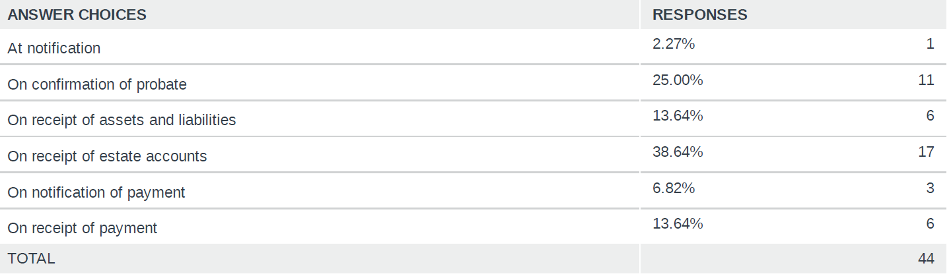
Which of the following best describes when you think charities should recognise legacy income?
This reveals that most charities are actually content with their current method and therefore that despite a recognition of the benefits of a unified approach most believe their own method is preferable.
The written submission to question 5 – “Do you believe that it would be preferable if all charities accounted for legacies in the same way” reveal concern at a change of approach despite 84% of respondents agreeing with the premise. Whilst the bulk of this submission pushes for uniformity we are very conscious of members concerns in this area.

Slide 11
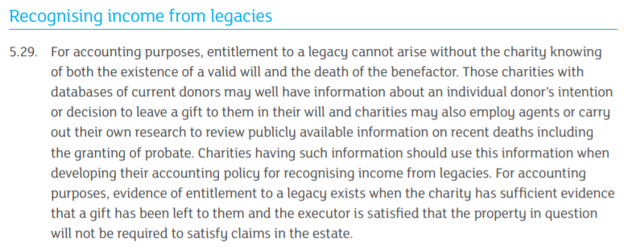
We don’t find this a clear and succinct start to the section on legacies and prefer 5.33 as a starting point or alternative wording.
The point of this section appears to be to drive charities to proactively identify legacies prior to being notified by the executor and presumably to account for them at an early stage.
However, the reference to the executor needing to be satisfied that the property in question is not required to satisfy claims in the estate allows a subjective judgement by executors to be a key factor and undermines the previous wording within 5.29

Slide 12
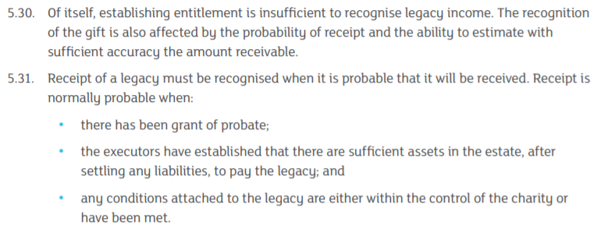
5.30 and 5.31 unhelpfully combine measurement and probability of receipt. These are distinct and should not be included within single sections of SORP.
Probability of receipt is a judgement for charities and will include assessments of potential claims or on occasion the economics of collecting an unpaid legacy from a missing or fraudulent executor.
Measurement requires knowledge of the Net Estate (being Assets less liabilities) together with either an estimate of the expenses of administering the estate or actual figures for such expenses. Further comment on this can be found in respect of 5.32.

Slide 13
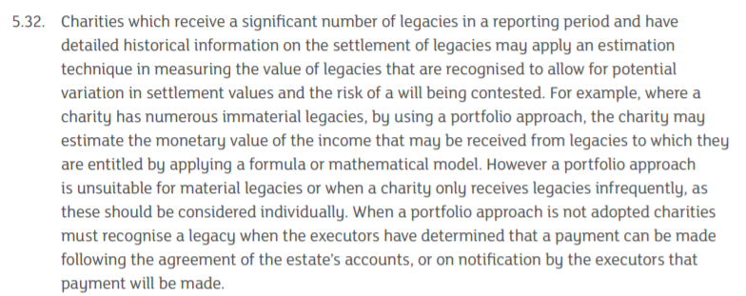
5.32 could provide clear guidance on how a charity should measure the value of an individual legacy. Instead it unhelpfully focuses on whether charities receive significant volume of legacies and appears to recommend different approaches dependent on the number of gifts received.
It seems possible for this section to recommend that charities identify the net estate from the grant of probate and that they should then attempt to make an estimate of the probably costs or where they feel unable to do so to request the executor provides such an estimate. It seems possible that sector wide data could be used to help charities make reasonable estimates of probable costs.
If it is thought that charities should have a choice as to whether to make an estimate for costs then wording could be provided as to when that is appropriate and what steps they should take to identify the actual costs. Charities should be clear in their accounts which method they use. Presumably those delaying inclusion would have more legacies listed as contingent assets and consideration should be given as to whether this would require more rigour in the contingent assets section that would otherwise be the case.

Slide 14
If it is thought that charities should have a choice as to whether to make an estimate for costs then wording could be provided as to when that is appropriate and what steps they should take to identify the actual costs. Charities should be clear in their accounts which method they use. Presumably those delaying inclusion would have more legacies listed as contingent assets and consideration should be given as to whether this would require more rigour in the contingent assets section that would otherwise be the case.

Slide 15
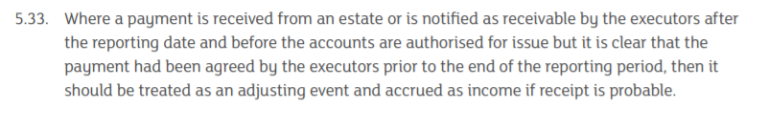
This section adds no value. If charities are already recognising income on the basis of the value of the net estate less expenses they will already have recognised the income.
More helpfully this section should emphasise that charities need only concern themselves with any material legacy after the end of the reporting period (or cut off?)
Charities spend considerable resources considering whether information receive after the end of the reporting period constitutes an adjusting event. The focus should clearly be on large and therefore material gifts for that charity where entitlement existed at the end of the accounting period.
For most charities income is relatively smooth other than material legacies and it is not important for readers of the accounts that legacies that were not recognisable before the end of the accounting period are written back to the prior year as long as the accounting process is consistent year on year.

Slide 16
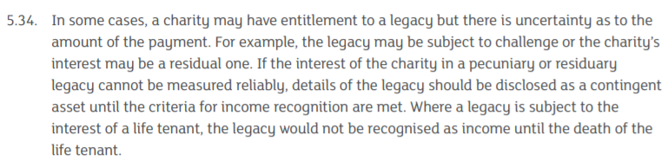
5.34 appears to conflate measurement and probability of receipt. Its guidance on measurement is unhelpful as it contradicts 5.32 in suggesting that charities should not estimate the value of residuary gifts.
The point on life interest gifts is good but should be in a separate section or included within an early section defining entitlement.
There are arguments as to whether a claim against an estate impacts probability of receipt or in fact entitlement. Whatever the conclusion on that the point, it is clear that legacies should not be recognised where a potentially valid claim that places doubt on a charities entitlement to, or receipt of, a gift exist.

Slide 17
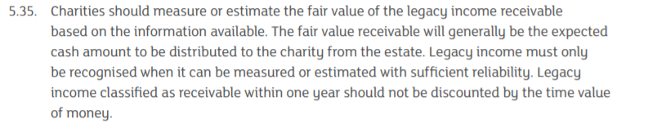
This section is clear and would appear to be a better starting point for the whole discussion of legacy accounting than 5.29, albeit the last sentence is a precursor to 5.36 which follows and might just as well form part of that section.
This is one of the sections which appears to drive at early recognition but it is of course conflicted by several other sections of the SORP guidelines as set out above.

Slide 18
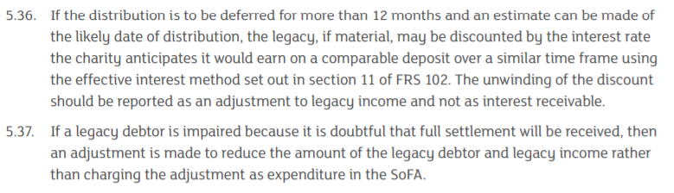
5.36 is an important clause and we have no issue with it other than to note the difficulty charities have defining when funds will be received meaning the calculation is a best effort estimation.
5.37 – This is again an important point and we think that it is important that charities recognising

Slide 19
Further points of consideration
Charities currently adopt a wide range of methods for accounting for legacies and whilst there are benefits from a unified approach it is important to note that forcing charities to change their accounting method might not be welcomed and could lead to confusing accounts in the transitionary year following adoption of an alternative method.
Most large charities have moved in the direction or early recognition and not only are comfortable with their approach there would be great opposition from being required to delay recognition as this would leave a very significant accounting hole.
Many charities continue to await until payment is made or at very least imminent and members of our engagement strand were, perhaps surprisingly, strongly in favour of charities not accounting for legacy income until the funds are received. There is considerable concern that legacies might be accounted for and then later removed at that this would be very detrimental as it might appear a charity has a healthier financial position than is the case. The counter to that it is that this would be removable if the adjusting event took place before signing and if it did not then frankly the justification for not revealing the gifts existence is dubious.
Both our survey data and conversations as part of the engagement strand appear to support a tiered approach or at least an option between those recognising early and late despite this conflicting with the aim of having a unified approach. We are not opposed to this as a pragmatic solution as long as more unity of approach is worked towards.

Slide 20
Clear Software
“Clear has over 100 charities now using our bespoke legacy administration software, FirstClass. This includes the majority of high and medium legacy ‘earning’ charities.
Our software is used to identify and record the value of each legacy and to amend that estimate as the matter progresses. The software is then used to then record the sum received and crucially to identify the sum due, for each individual legacies and the whole portfolio. Some or all of the sum due is then “accrued” within accounts subject to the individual charities accounting polices
The challenge we face is that no two charities use the same accrual rules. Some charities accrue for the balance outstanding whereas others calculate the Accrual Value by reducing the Balance Outstanding by a given percentage. Some charities require a will to have been received, some need probate to have been granted, some require assets and liabilities to have been received, other require final accounts. The varied nature of charities accounting principles means we must develop reports for each individual charity.
A unified approach would assist us in developing functionality and automation and could save time allowing legacy officers to focus on working with executors to maximise the value of the legacies received. We have been unable to develop increased automation due to the variance in accounting rules. A streamlined approach would also reduce the extent of training required when a legacy officer or Legacy Link consultant starts a new role”

Slide 21
Legacy Foresight
‘Legacy foresight works with over 100 UK charities offering a range of services that includes benchmarking, research projects, consultancy projects and a forecasting service that provides charities with forecasts of future income and bequest numbers under a range of differing assumptions.
It has been with the provision of our legacy income forecasts that the treatment of accruals has become an increasing concern to us over recent years. Historically most our forecasts were generated on a ‘cash’ basis (thus taking no account of accruals) but over recent years more and more charities have requested that the forecasts be supplied on a ‘recognised’ income basis i.e. incorporating accruals into the figures to be forecast. It has been clear that there is a very wide difference between charities in the way they treat accruals, in terms of the criteria they use to judge whether future likely income should be included or not. The fact that there is no common approach to the treatment of accruals has made it extremely difficult for us to have a common approach in our forecasting methodology. In much of our benchmarking work it also makes comparison between charities increasingly difficult as we are not necessarily looking at the same thing when comparing charities.
If a more streamlined and clearly defined approach could be adopted across the sector it would make our job easier and the results of our work more easily interpreted by charities. The current situation causes confusion and such a situation is clearly not optimal. I am sure that all charities would benefit if a more tightly defined approach to the treatment of accruals were adopted.’

Slide 22
Legacy Link
“Legacy Link has a client base of over 70 charities we work with on a monthly basis, supporting them with all aspects of their legacy administration whether it be a full long term outsourcing of the process, or providing short term cover as needed. We have the most capacity in the sector to be able to flex to a charity’s needs and react quickly to the requirements of the charities we work with.
Our work often involves dealing with the Legacy and Finance teams of a charity; helping them to obtain figures for accruals and reporting of revenue. As charities have become more focussed on their forecasting and reporting in recent years, even before the more recent pressures on income due to Covid-19, we have identified an increased disparity regarding how legacy income is recognised, despite the clarity that SORP 2015 sought to bring. As a chartered accountant and ex auditor this has been concerning to witness. Our experience tells us this is due to the charities not being aware of how their peers are accounting for the income and a wide difference in what the nature of ‘probable’ means. However, from our conversations with them none appear steadfastly held to one way of doing it if there was deemed to be a more defined way.
Across the sector the broad differences in when charities accrue for legacy income is clearly having a huge impact on the Financial Statements. While the accounting principles are consistently applied, the interpretation of them creates hugely material variances for charities that can massively affect the annual numbers. Some will include income from almost all notifications as soon as a Smee & Ford is received, while others will accrue virtually nothing until the funds have been received. While legacy income is a unique income source for a charity, for no other type of income could there be such an opportunity to have a variance which for the larger charities could go into the millions of pounds.
As such we would be very much in favour of a more unified, closely defined approach that removes the opportunity for such wide interpretations and gives greater consistency across the sector.”

